Slide 1
Time-series Analysis Foreign Exchange Rates with ARIMA model
Adit Deshpande (10505324)
Monika Tambe (10523237)
Aliasgar Electricwala (10532445)

Slide 2
Definition – Time series Analysis
Series of data points listed in time order.
Commonly taken at successive, equally spaced points in time.
Components of time series:
1. Secular Trend(T):
Gradual long term movement(up or down). Easiest to detect
e.g. Population growth In India
2. Cyclical Patterns(C):
Results from events recurrent but not periodic in nature. An up-and-down repetitive movement in demand. repeats itself over a long period of time
e.g. Recession in US Economy
3. Seasonal Pattern(S):
Results from events that are periodic and recurrent in nature. An up-and-down repetitive movement within a trend occurring periodically. Often weather related but could be daily or weekly occurrence
e.g. Sales in festive seasons
4. Irregular Component(I):
Disturbances or residual variation that remain after all the other behaviours have been accounted for. Erratic movements that are not predictable because they do not follow a pattern
e.g. Earthquake

Slide 3
Phase 1: Understanding the business
Time series are very helpful in study of past behaviour of business. On this basis , we can invest our money in that type of business. It is duty of businessman to make time series of past sale or profit and see what is the trend of sale or profit in that type of business.
The foreign exchange market is undoubtedly one of the world’s largest sectors. Exchange rates play and important role in controlling dynamics of foreign exchange market.
Predicting exchange rates has become challenging because unpredictability of financial time series forecasting .
Various economic factors such as inflation, economic growth, interest rates and monetary policies influence the value at which national currencies are traded in international markets. Therefore, the exchange rates play a vital role in controlling dynamics of the foreign exchange market.

Slide 4
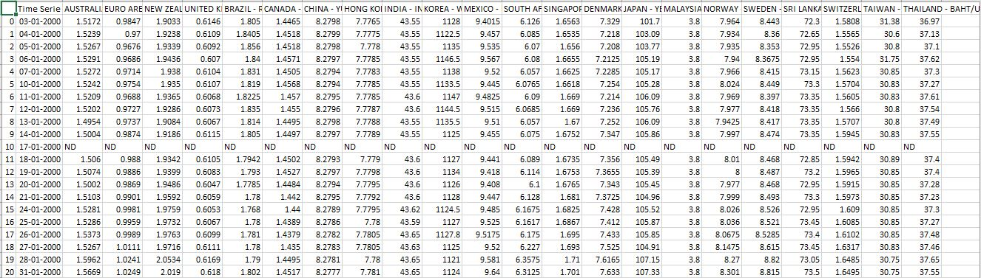
Phase 2: Understanding the data
Data was downloaded from https://www.kaggle.com/brunotly/foreign-exchange-rates-per-dollar-20002019 in excel sheet format
The dataset has information about 24 different currencies against US dollars from the year 2000 to 2019.

Slide 5
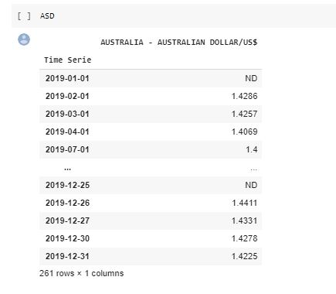
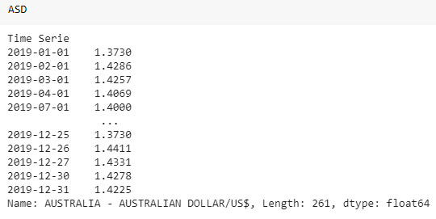
Phase 3: Data Preparation
Converting data into time series object:
Dataset was uploaded to the new notebook in Google colab.
Then data was converted into time series object.
We have selected column of Australian dollar for year 2019.
All values already in dollars therefore there is no need of normalisation, but there are some missing values which are replaced with mean value.
Original Dataset
After Converting

Slide 6
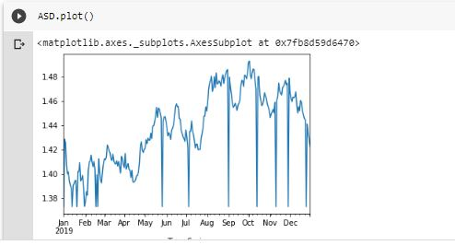
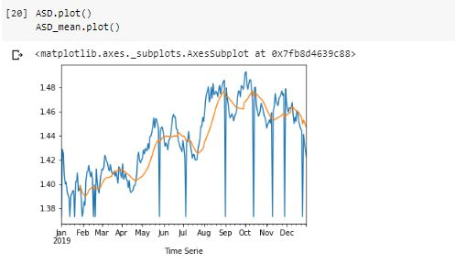
Smoothing based method – Moving averages
Smoothing data removes random variation and shows trends and cyclic components.

Slide 7
Data Modelling – ARIMA MODEL
ARIMA (Auto Regressive Integrated Moving Average)
It is based on the assumption that over a period of times the current values are related or correlated with their immediate previous or n previous values.
Arima (p, d, q)
P = values from partial autocorrelation.
D = lagged difference between current and previous values.
Q = value from autocorrelation.
Arima model is built on the basis of these parameters and their values are as follows:
p = 20
d = 0
q = 5

Slide 8
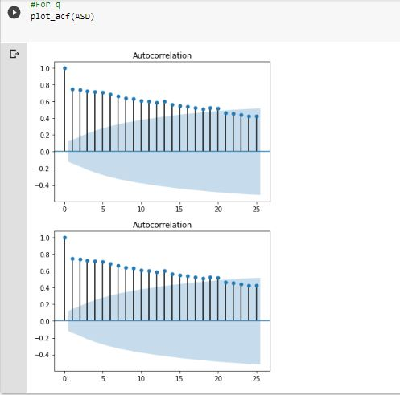
Implementation of ARIMA
Autocorrelation:
ACF stands for Autocorrelation and it refers to how correlated a time series is with its past values whereas the acf is the plot used to see the correlation between the points, up to and including the lag unit.

Slide 9
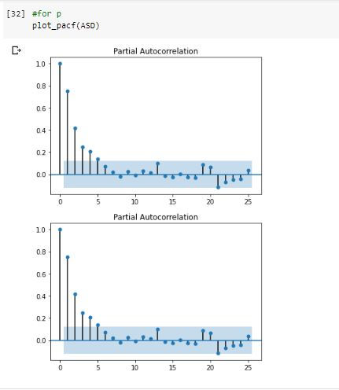
Partial autocorrelation:
PACF stands for Partial Autocorrelation is the amount of correlation between a variable and a lag of itself that is not explained by correlations at all lower-order-lags.

Slide 10
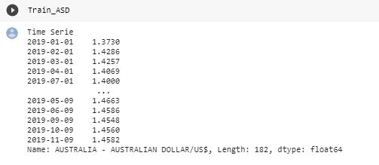
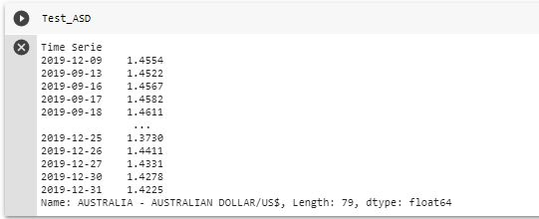
Data Splitting
Data is splitted into two parts that is train and test.
Train Data
Test Data

Slide 11
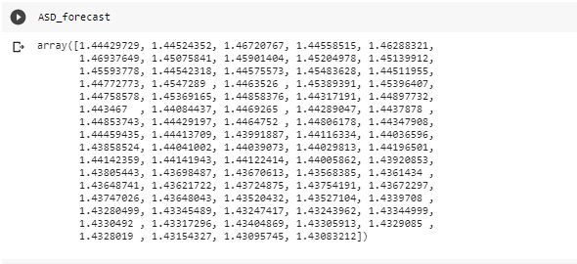
Result from ARIMA method
Forecasting:
Finally after forecasting we can see that there is very less difference between original and forecasted value.

Slide 12
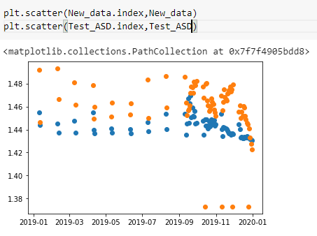
In the following graph we can see the forecasted as well the original values:

Slide 13

AIC : Akaike Information Criteria
AIC (Akaike Information Criteria) – The analogous metric of adjusted R² in logistic regression is AIC. AIC is the measure of fit which penalizes model for the number of model coefficients. Therefore, we always prefer model with minimum AIC value.
AIC value of model is -958.479129066107

Slide 14

Evaluation
Whenever a model is built it is necessary to be evaluated with another sample of data to check whether the desired output is obtained.
There are two metrics by which the error is calculated RMSE and MAPE.
Root Mean Square Error: The formula for calculating RMSE is given by
RMSE= √{[(y1-f1)^2+(y2-f2)^2+…..(yk-fk)^2]/K}
Yk-Actual value
fK-Forecasted value
K-Number of observations
Smaller the value of RMSE, better is the forecasting model.

Slide 15
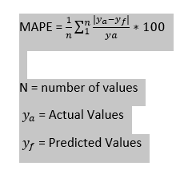

Mean Absolute Percentage Error: The formula for calculating MAPE is given by
Thus, MAPE value is:

Slide 16
Deployment
This entire project was built on some sample data collected from Kaggle.
As we have observed that there is very less error in our time series forecasting we can deploy this model.
For deployment we take data from data source where everyday current currency rate would be collected.
Then this will be passed through the model and for some time frame the prediction can be made.
The predicted data and the original data can be visualized using tableau dashboards, this dashboard can be designed to view data of various years and compare if the predicted rates have some similarity with past year data.

Slide 17
Thank You

